Slide 1
Markov Decision Processes

Slide 2
The relationship between actions & consequences is not deterministic, but is stochastic (random)
Poker or Nlackjack Possible with methods till studied now.

Slide 3
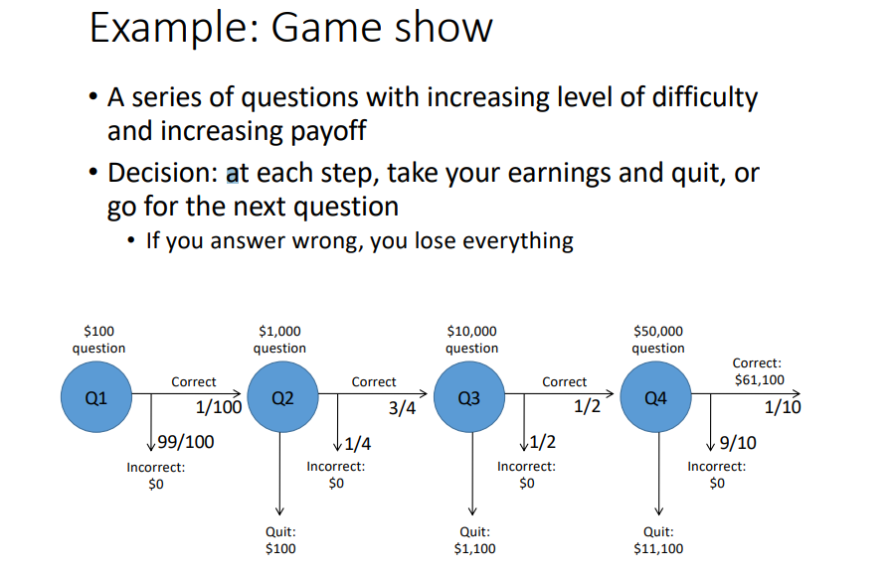

Slide 4
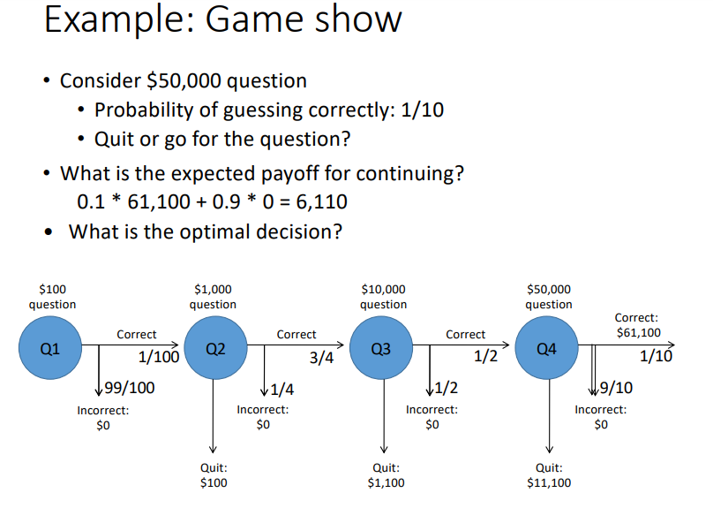

Slide 5
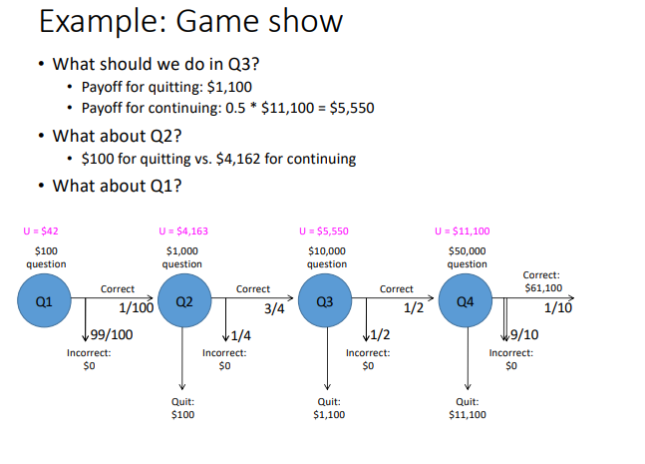

Slide 6
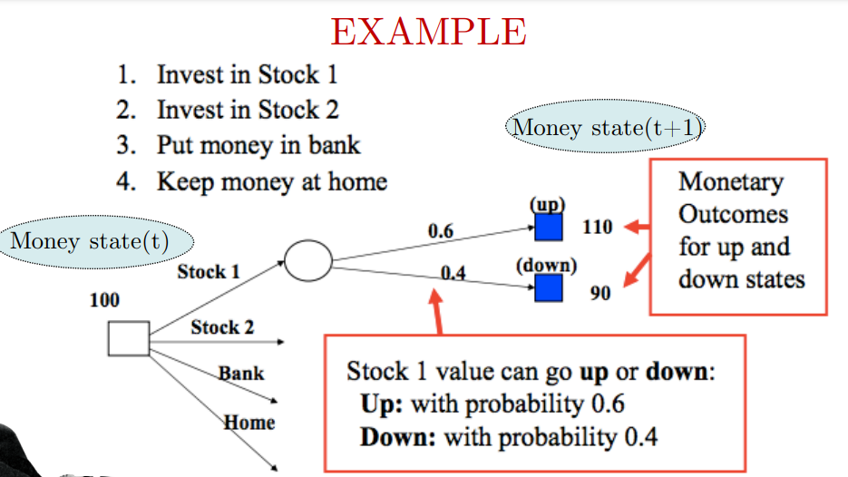
Introduction

Slide 7
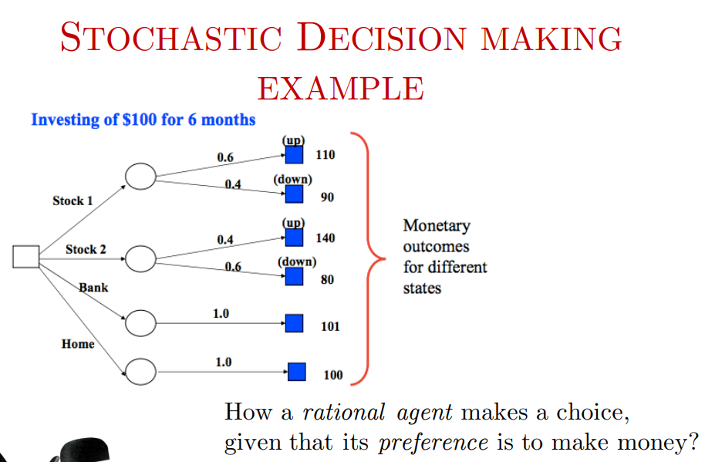

Slide 8
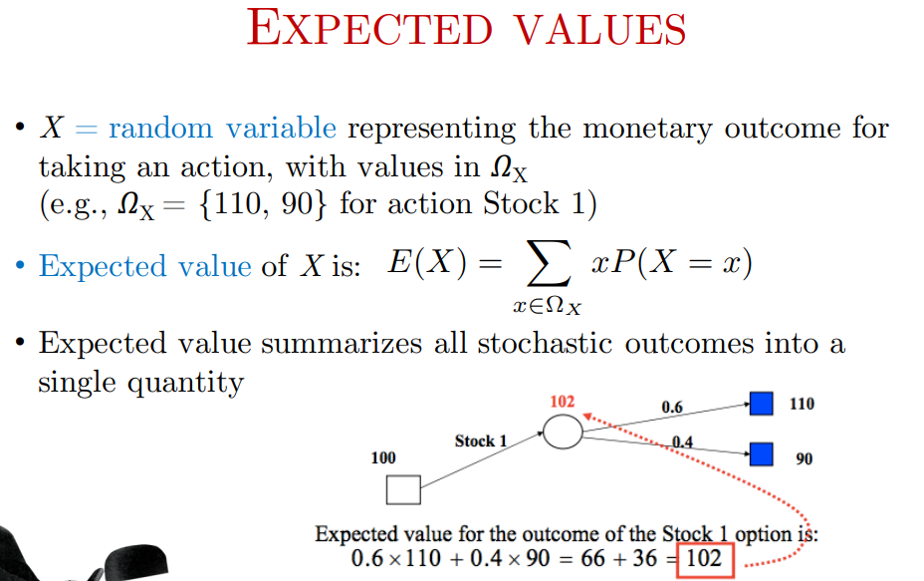

Slide 9
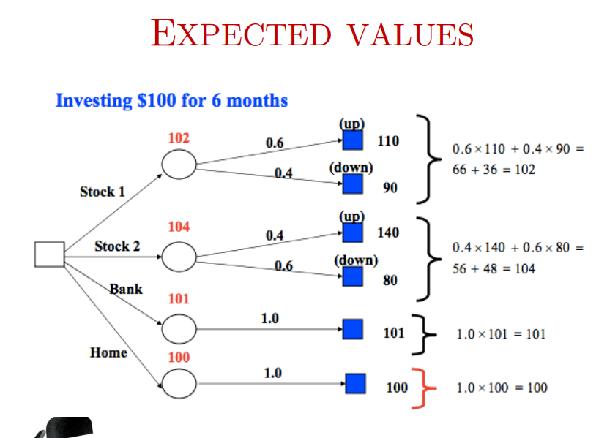

Slide 10
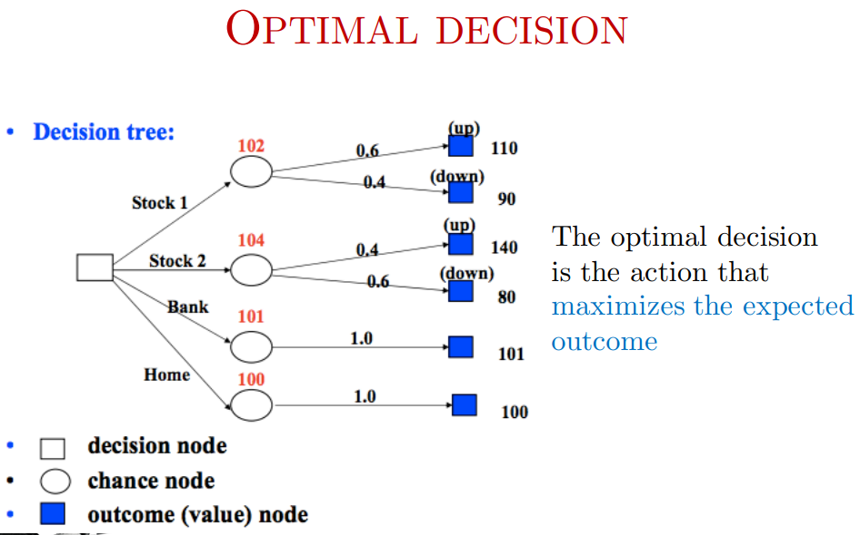

Slide 11
MDP Context vs. Search Context
MDP: Decision-making under uncertainty with rewards and penalties.
Search Methods: Finding a path from start to goal, often with a set end state
Probabilistic Outcomes
Game Show: Probabilities of success and risk of failure at each step.
Search Methods: Typically, deterministic transitions between states (e.g., BFS)
Goal: Reward Maximization vs. Pathfinding
Game Show: Aim to maximize cumulative reward
Search Methods: Focus on finding an optimal path to the goal (not on rewards)
Dynamic Decision-Making
MDP: Reevaluate strategy based on risks/rewards at each step.
Search Methods: Follow a defined strategy without reward-risk assessment
Game Show (MDP): Sequential, probabilistic, reward-driven
Search Methods: Deterministic, path-driven, goal-oriented

Slide 12
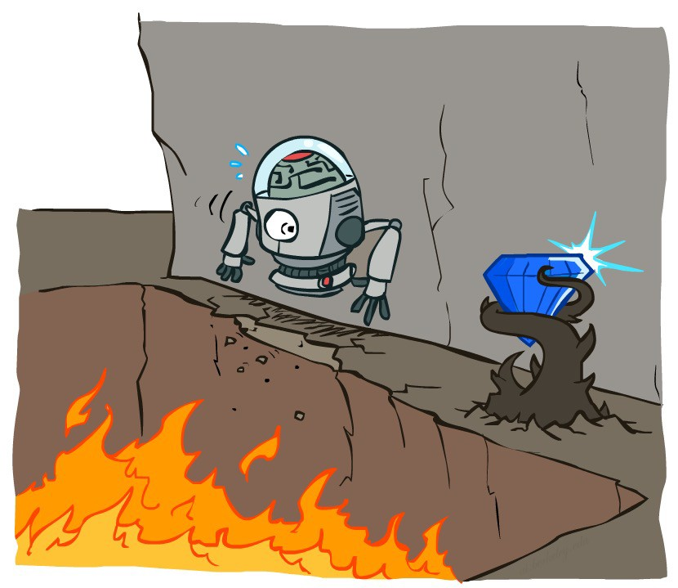
Non-Deterministic Search

Slide 13





Example: Grid World
A maze-like problem
The agent lives in a grid
Walls block the agent’s path
Noisy movement: actions do not always go as planned
80% of the time, the action North, takes the agent North . (if there is no wall there)
10% of the time, North takes the agent West; 10% East
If there is a wall in the direction the agent would have been taken, the agent stays put
The agent receives rewards each time step ( how it is different from Search formulation ?)
Reward depends on agent’s state and action
Can be positive, zero or negative
Goal: maximize sum of rewards
Notes:
[cut demo of moving around in grid world program]

Slide 14
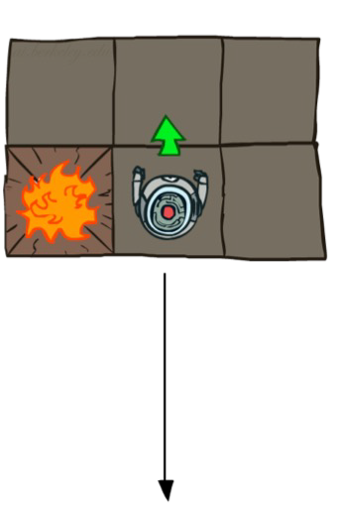
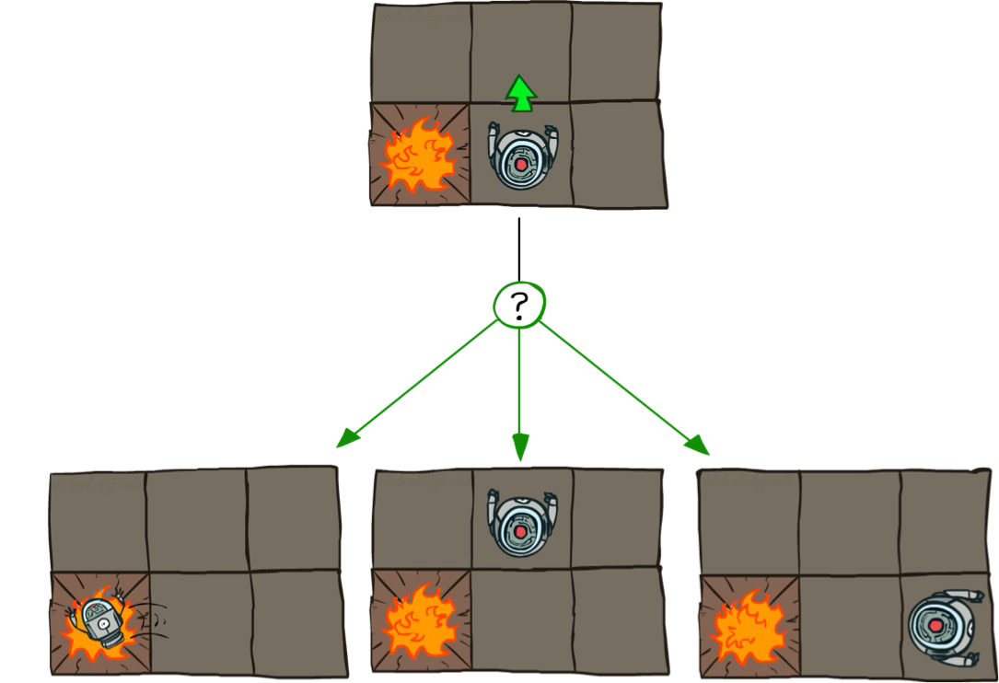
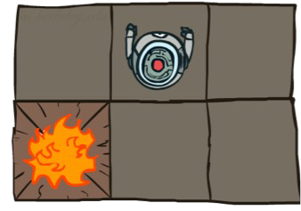
Grid World Actions
Deterministic Grid World
Stochastic Grid World
0.1
0.1
0.8

Slide 15
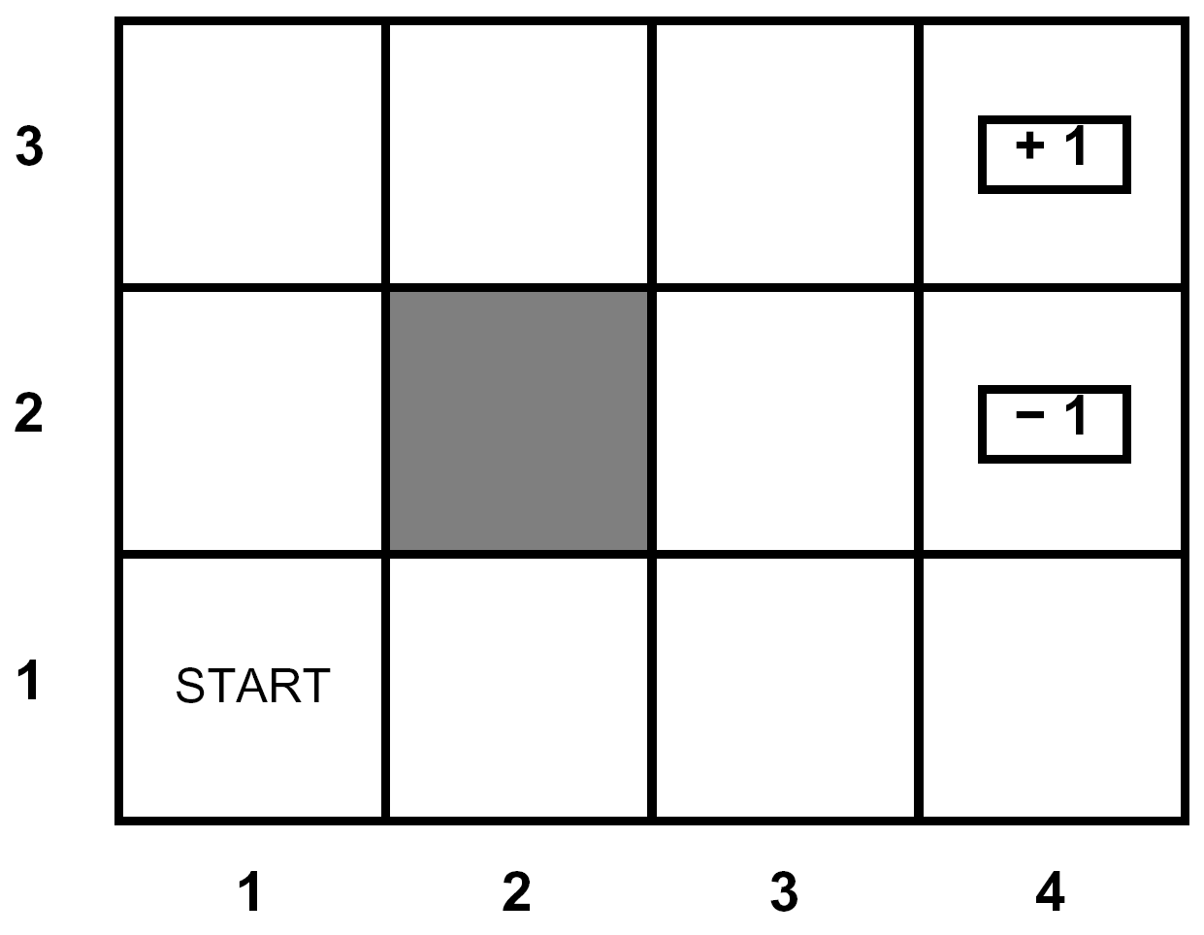
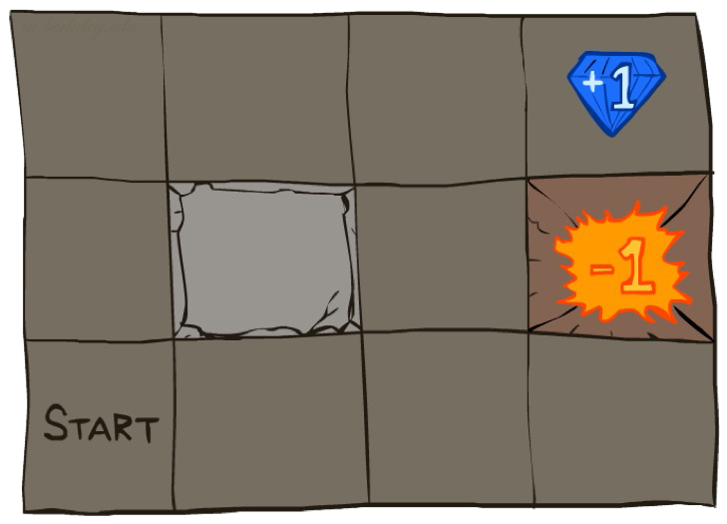




Markov Decision Processes
An MDP is defined by:
A set of states s ∈ S
A set of actions a ∈ A
A transition function T(s, a, s’)
Probability that a from s leads to s’, i.e., P(s’| s, a)
Also called the model or the dynamics
A reward function R(s, a, s’)
Sometimes just R(s) or R(s’)
MDPs are modeled with small "living" rewards at each step to reward an agent’s survival
along with large rewards for arriving at a terminal state
A start state
Possible one or more terminal state

Slide 16

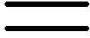
What is Markov about MDPs?
“Markov” generally means that given the present state, the future and the past are independent
For Markov decision processes, “Markov” means action outcomes depend only on the current state
Andrey Markov (1856-1922)
This is just like search, where the successor function could only depend on the current state (not the history)
Ignore History

Slide 17

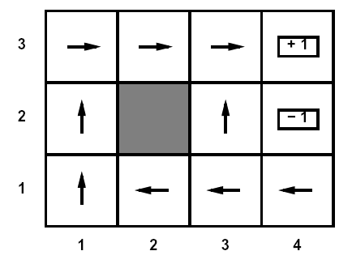
Policies
In deterministic single-agent search problems, we wanted an optimal plan, or sequence of actions, from start to a goal
For MDPs, we want an optimal policy π*: S → A
A policy π gives an action for each state
An optimal policy is one that maximizes expected utility if followed
Expectimax didn’t compute entire policies
It computed the action for a single state only

Slide 18
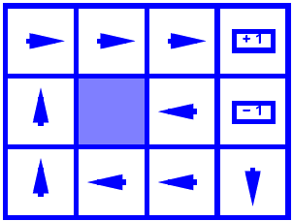
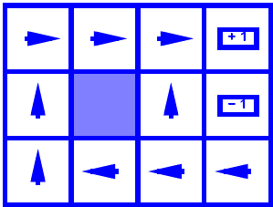
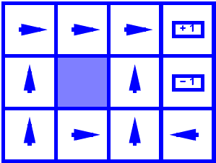
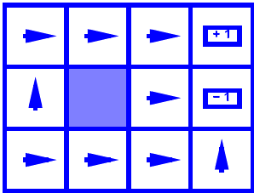
Optimal Policies
R(s) = -0.01
R(s) = -0.03
Any end state
R(s) = -0.4
R(s) = -2.0

Slide 19
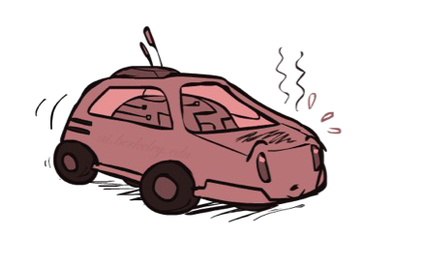
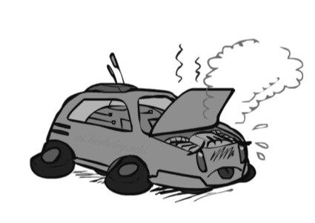

Example: Racing
Just like in a state-space graph, each of the three states is represented by a node, with edges representing actions.
For nondeterministic actions, there are multiple edges representing the same action from the same state with differing successor states
A robot car wants to travel far, quickly
Three states: Cool, Warm, Overheated
Two actions: Slow, Fast
Going faster gets double reward
+1
0.5
+1
1.0
Fast
Slow
-10
0.5
Warm
Slow
Fast
0.5 +2
Cool
0.5
Overheated
+1
1.0
+2
π*(Cool) = Fast
π*(Warm) = Slow
π*(Overheated) = end
Optimal Policy:
How could we have discovered this optimal policy ?

Slide 20
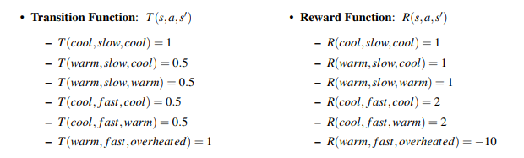
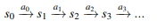
Example: Racing
We represent the movement of an agent through different MDP states over time with discrete timesteps, defining s_{t} ∈ S and a_{t} ∈ A as the state in which an agent exists and the action which an agent takes at timestep t respectively.
The movement of an agent through a MDP can thus be modeled as follows:
An agent’s goal is to maximize it’s reward across all timesteps

Slide 21



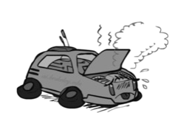
Racing Search Tree As Expectimax
. . .
. . .
. . .
. . .
. . .
. . .
. . .
. . .

Slide 22
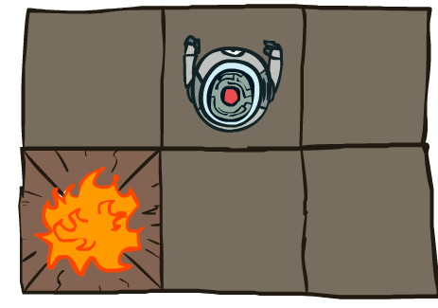
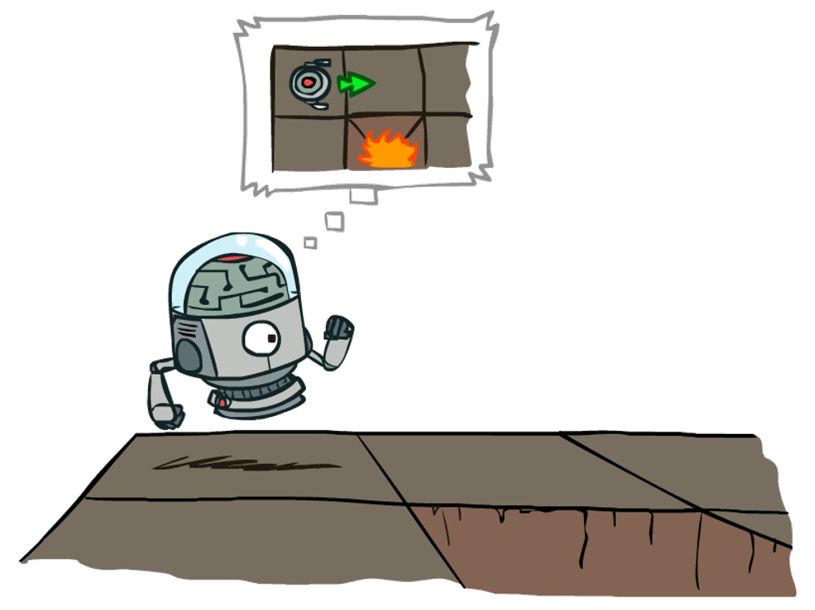

MDP Search Trees
Each MDP state projects an expectimax-like search tree
s
s is a state
a
(s, a) is a
q-state
s, a
(s,a,s’) called a transition
T(s,a,s’) = P(s’|s,a) R(s,a,s’)
T(s,a,s’)
Uncertainty is modeled in these search trees with Q-states, also known as action states, essentially identical to expectimax chance nodes.
s’

Slide 23
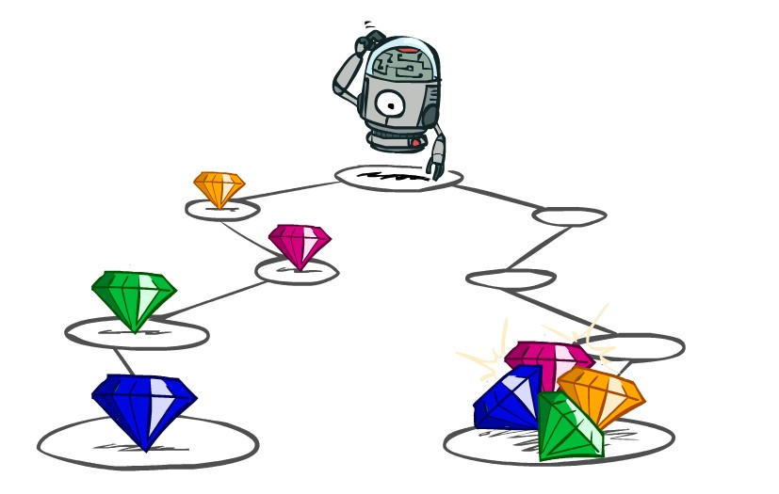
Utilities of Sequences
What preferences should an agent have over reward sequences?
More or less?
[1, 2, 2] or [2, 3, 4]
[0, 0, 1] or [1, 0, 0]
Now or later?

Slide 24




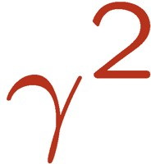

Discounting
Inherent problem with our Racecar MDP - haven’t placed any time constraints on the number of timesteps for which a racecar can take actions and collect rewards.
With our current formulation, it could routinely choose a = slow at every timestep forever, safely and effectively obtaining infinite reward without any risk of overheating.
One solution: values of rewards decay exponentially
Worth Now
Worth Next Step
Worth In Two Steps
0.8
0.64

Slide 25
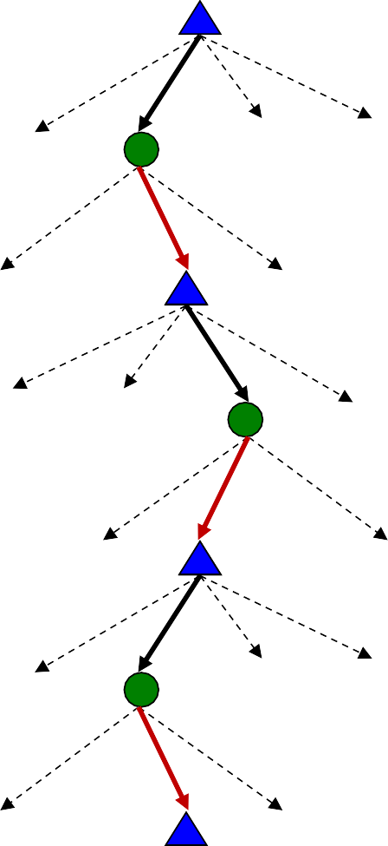

Discounting
How to discount?
Each time we descend a level, we multiply in the discount once
Why discount?
Sooner rewards probably do have higher utility than later rewards
Also helps our algorithms converge
Example: discount of 0.5
U([1,2,3]) = 1*1 + 0.5*2 + 0.25*3 = 2.75
U([3,2,1]) = 1*3 + 0.5*2 + 0.25*1 = 5.25
U([1,2,3]) < U([3,2,1])
Prefer larger rewards earlier on.

Slide 26

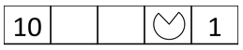
Discounting
Given:
Actions: East, West, and Exit (only available in exit states a, e)
Transitions: deterministic
Quiz 1: For γ = 1, what is the optimal policy?
Quiz 2: For γ = 0.1, what is the optimal policy?

Slide 27

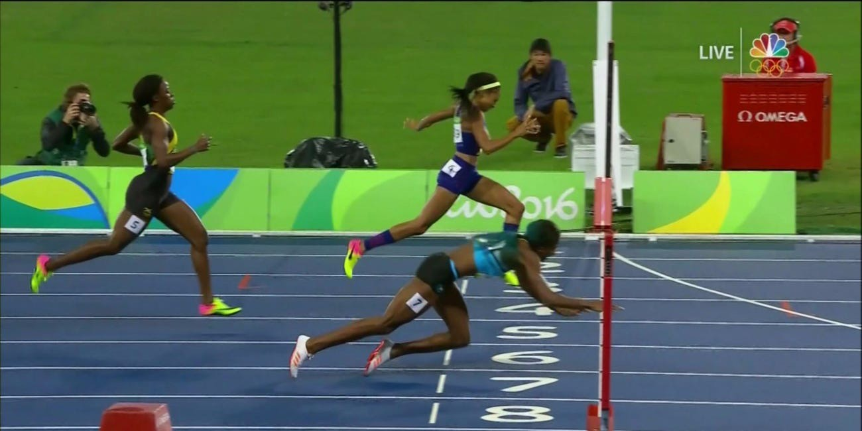
Infinite Utilities?!
Problem: What if the game lasts forever? Do we get infinite rewards?
Solutions:
Finite horizon: (similar to depth-limited search)
Terminate episodes after a fixed T steps (e.g. life)
Gives nonstationary policies (π depends on time left)
Shaunae Miller wins 400m gold medal in 2016 Olympics [Photo credit: NBC]

Slide 28
Infinite Utilities?!
Problem: What if the game lasts forever? Do we get infinite rewards?
Solutions:
Finite horizon: (similar to depth-limited search)
Terminate episodes after a fixed T steps (e.g. life)
Gives nonstationary policies (π depends on time left)
Discounting: use 0 < γ < 1
Smaller γ means smaller “horizon” – shorter term focus
Absorbing state: guarantee that for every policy, a terminal state will eventually be reached (like “overheated” for racing)

Slide 29
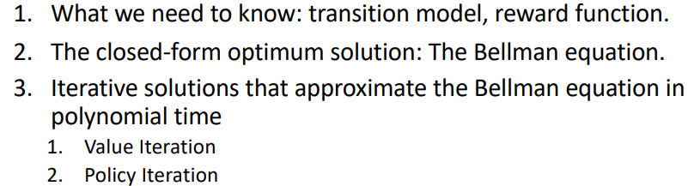
Recap: Defining MDPs
Markov decision processes:
Set of states S
Start state s₀
Set of actions A
Transitions P(s’|s,a) (or T(s,a,s’))
Rewards R(s,a,s’) (and discount γ)
MDP quantities so far:
Policy = Choice of action for each state
Utility = sum of (discounted) rewards
s
a s, a
s,a,s’
s’
To solve MDP what we need

Slide 30
Recall: Racing
A robot car wants to travel far, quickly
Three states: Cool, Warm, Overheated
Two actions: Slow, Fast
Going faster gets double reward
+1
0.5
+1
1.0
Fast
Slow
-10
0.5
Warm
Slow
Fast
0.5 +2
Cool
0.5
Overheated
+1
1.0
+2

Slide 31
Racing Search Tree
Chance Encounters: Expectimax search is used for finding optimal decisions in games where there is an element of chance.
For example, in Tic-Tac-Toe, the outcome of the game can depend on the opponent's moves, which can be uncertain.
Expected Outcome: It considers all possible opponent responses and picks the move with the highest average (expected) utility for the player.
. . .
. . .
. . .
. . .
. . .
. . .
. . .
. . .

Slide 32


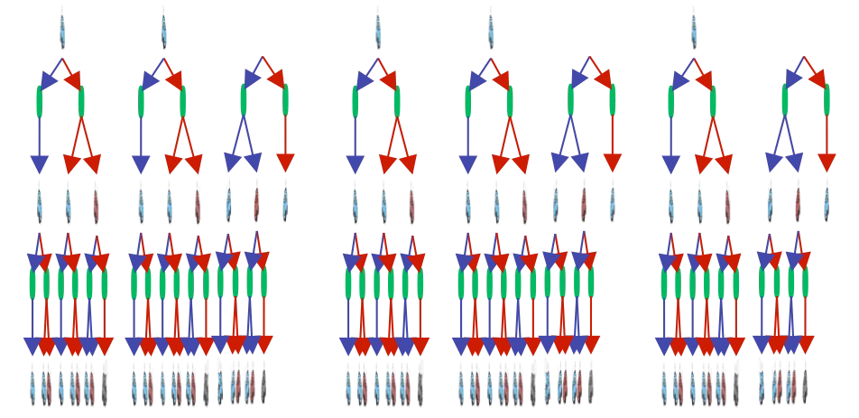
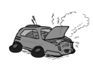
Racing Search Tree
We’re doing way too much work with expectimax!
(It considers all possible opponent responses and picks the move with the highest average (expected) utility for the player.)
Problem: States are repeated
Idea: Only compute needed quantities once, cache the rest in a lookup table (store the results of calculations so that they don't have to be done again.)
Problem: Tree goes on forever
Idea: Do a depth-limited computation, but with increasing depths until change is small
Note: deep parts of the tree eventually don’t matter if γ < 1
(A discount factor of less than 1 means that future rewards are worth less than immediate rewards. )

Slide 33
Optimal Quantities
The value (utility) of a state s:
V*(s) = expected utility starting in s and acting optimally
V*(s)
s is a state
s
a
(s, a) is a q- state
The value (utility) of a q-state (s,a):
Q*(s,a) = expected utility starting out having taken action a from state s and (thereafter) acting optimally
Q*(s,a)
s, a
T(s,a,s)’
(s,a,s’) is a
transition
s’
The optimal policy:
π*(s) = optimal action from state s

Slide 34
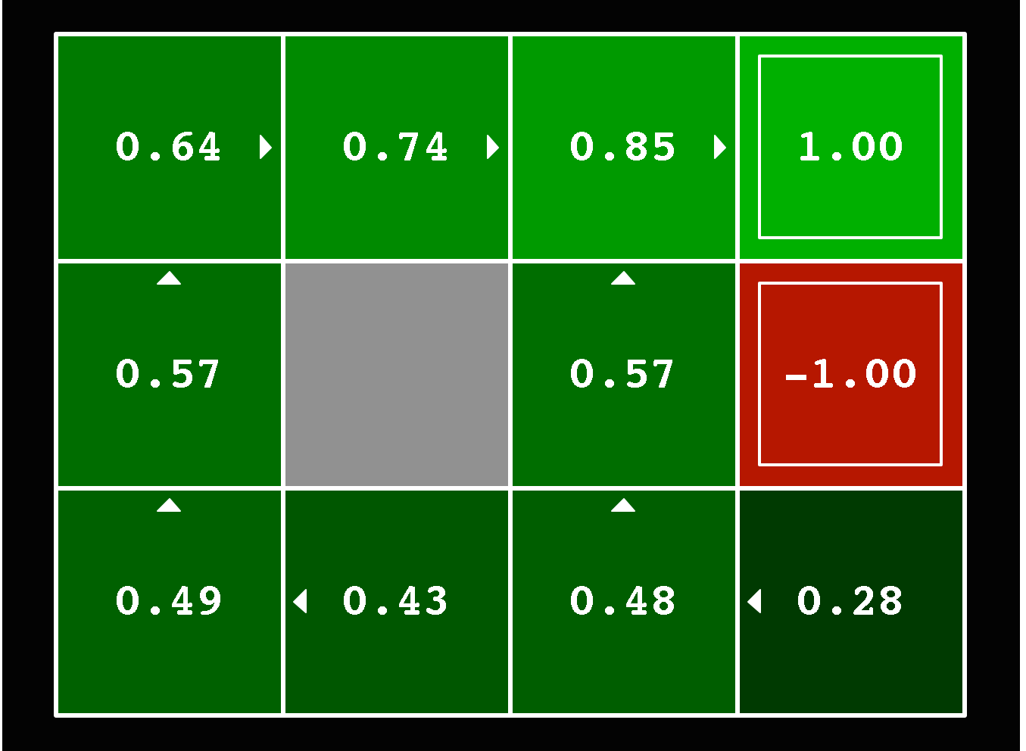
Optimal Quantities
The value (utility) of a state s:
V*(s) = expected utility starting in s and acting optimally
The value (utility) of a q-state (s,a):
Q*(s,a) = expected utility starting out having taken action a from state s and (thereafter) acting optimally
The optimal policy:
π*(s) = optimal action from state s
Here V*(s) is a lookup table with 11 entries

Slide 35
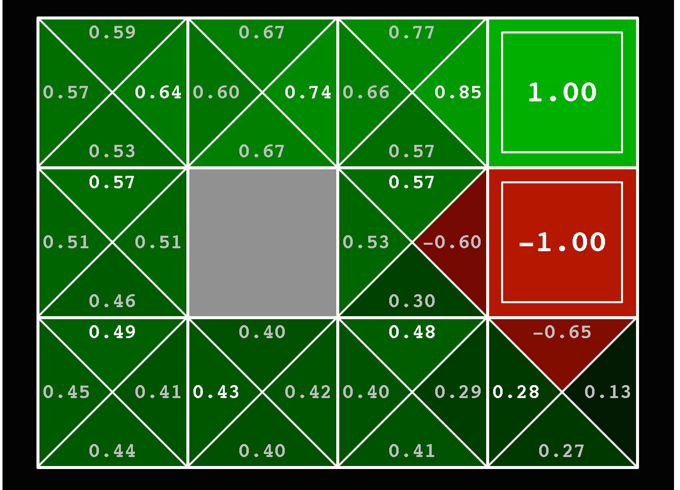
Optimal Quantities
The value (utility) of a state s:
V*(s) = expected utility starting in s and acting optimally
The value (utility) of a q-state (s,a):
Q*(s,a) = expected utility starting out having taken action a from state s and (thereafter) acting optimally
The optimal policy:
π*(s) = optimal action from state s
Here Q*(s,a) is a lookup table with 9*4+2 entries

Slide 36
Optimal Quantities
The value (utility) of a state s:
V*(s) = expected utility starting in s and acting optimally
The value (utility) of a q-state (s,a):
Q*(s,a) = expected utility starting out having taken action a from state s and (thereafter) acting optimally
The optimal policy:
π*(s) = optimal action from state s
Here π*(s) is a lookup table with 11 entries

Slide 37
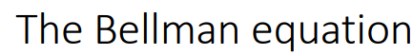
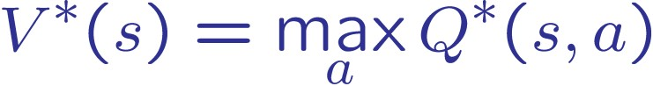
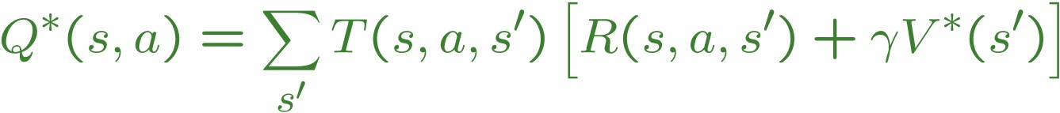
Recursive relationship between the utilities of successive states:
How to find this value V in the Expectimax search
Question: If you have Q*, how to get V*?
V*(s)
s
s is a
state
Question: If you have V*, how to get Q*?
a
(s, a) is a
q-state
Q*(s,a)
s, a
T(s,a,s’)
s’
(s,a,s’) is a
transition
V*(s’)

Slide 38
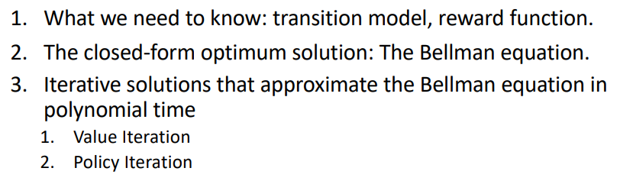

Slide 39
Value Iteration
Start with V₀(s) = 0: no time steps left means an expected reward sum of zero
Given vector of V_{k}(s) values, do one step of expectimax from each state:
V_{k+1}(s)
a s, a
Repeat until convergence, which yields V*
s,a,s’
V_{k}(s’)
Complexity of each iteration: O(S²A)
Theorem: will converge to unique optimal values
Basic idea: approximations get refined towards optimal values
Policy may converge long before values do

Slide 40
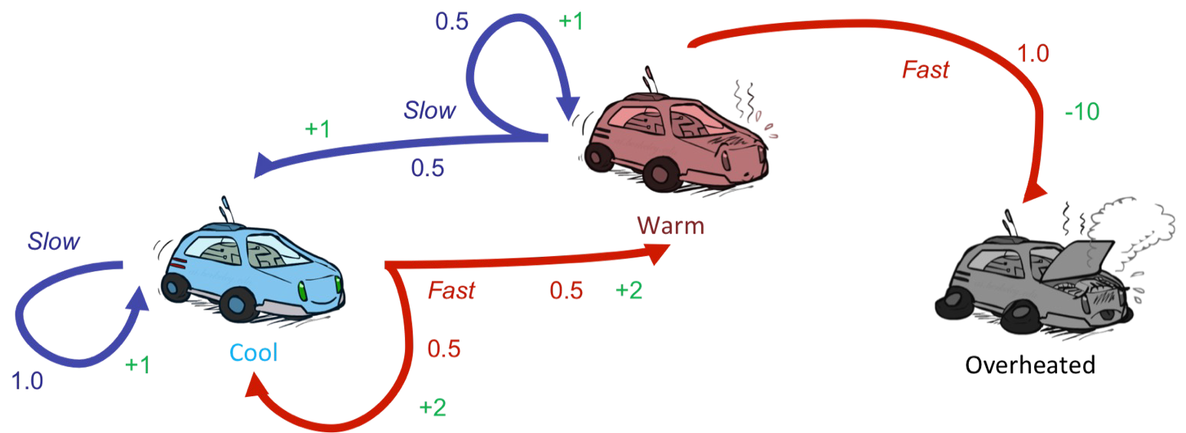


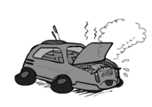
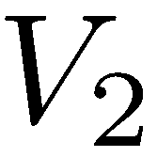
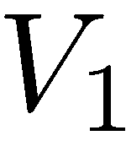
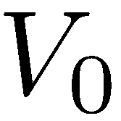
Example: Value Iteration
Assume no discount!
0
0
0

Slide 41
Example: Value Iteration
?
Assume no discount!
0
0
0
a=slow:
1(1 + 0) = 1
a=fast:
0.5(2 + 0) + 0.5(2 + 0) = 2

Slide 42
Example: Value Iteration
2
?
Assume no discount!
0
0
0
a=slow:
0.5(1 + 0) + 0.5(1 + 0) = 1
a=fast:
1(-10 + 0) = -10

Slide 43
Example: Value Iteration
?
2
1
0
Assume no discount!
0
0
0
a=slow:
1(1 + 2) = 3
a=fast:
0.5(2 + 2) + 0.5(2 + 1) = 3.5

Slide 44
Example: Value Iteration
3.5
?
0
2
1
0
Assume no discount!
0
0
0
a=slow:
0.5(1 + 2) + 0.5(1 + 1) = 2.5
a=fast:
1(-10 + 0) = -10

Slide 45
Example: Value Iteration
3.5 | 2.5 | 0
2 | 1 | 0
0 | 0 | 0
Assume no discount!

Slide 46
Value Iteration
Bellman equations characterize the optimal values:
V(s)
a s, a
T(s,a,s’)
V(s’)
Value iteration computes them:
Value iteration is just a fixed point solution method
There may be other methods to solve this Bellman equation

Slide 47
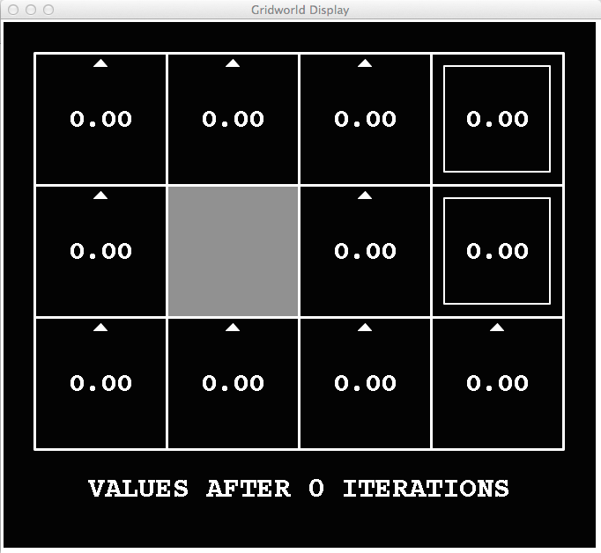
k=0
Noise = 0.2
Discount = 0.9
Living reward = 0

Slide 48
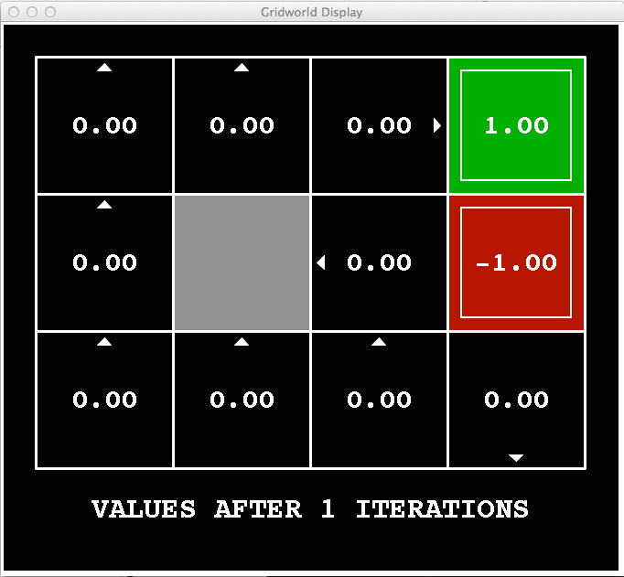

k=1
V₁(
)
V₁(s) is value of depth-1 expectimax from s

Slide 49
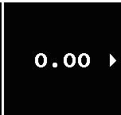
k=1
V₁(
)
V₁(s) is value of depth-1 expectimax from s

Slide 50
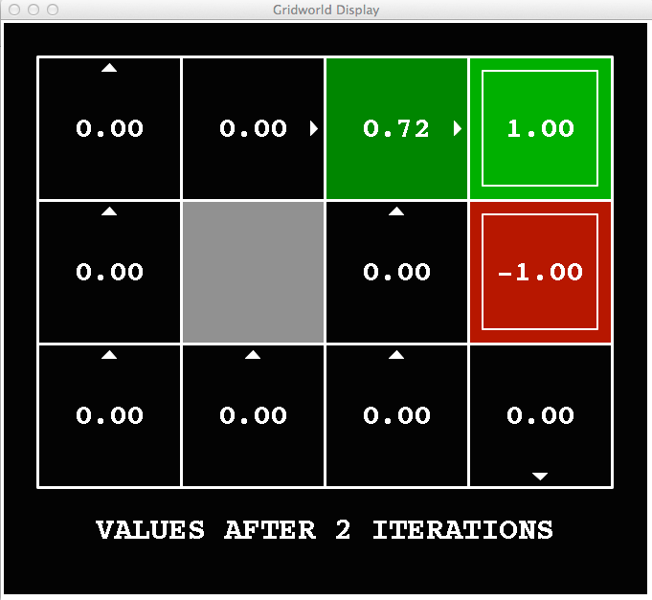

k=2
V₂(
)
V₂(s) is value of depth-2 expectimax from s

Slide 51

k=3
Noise = 0.2
Discount = 0.9
Living reward = 0

Slide 52

k=4
Noise = 0.2
Discount = 0.9
Living reward = 0

Slide 53

k=5
Noise = 0.2
Discount = 0.9
Living reward = 0

Slide 54

k=6
Noise = 0.2
Discount = 0.9
Living reward = 0

Slide 55

k=7
Noise = 0.2
Discount = 0.9
Living reward = 0

Slide 56

k=8
Noise = 0.2
Discount = 0.9
Living reward = 0

Slide 57

k=9
Noise = 0.2
Discount = 0.9
Living reward = 0

Slide 58

k=10
Noise = 0.2
Discount = 0.9
Living reward = 0

Slide 59

k=11
Noise = 0.2
Discount = 0.9
Living reward = 0

Slide 60

k=12
Noise = 0.2
Discount = 0.9
Living reward = 0

Slide 61

k=100
Noise = 0.2
Discount = 0.9
Living reward = 0

Slide 62
Problems with Value Iteration
Value iteration repeats the Bellman updates:
s
a s, a
Problem 1: It’s slow – O(S²A) per iteration
At each iteration, all |S| states must be updated.
Each state update involves iterating over all |A| actions to compute the Q-value for each action.
Computing each Q-value requires iteration over all |S| states again.
s,a,s’
s’
Problem 2: The “max” at each state rarely changes
Problem 3: The policy often converges long before the values

Slide 63
Problems with Value Iteration
Problem 2: The “max” at each state rarely changes
Problem 3: The policy often converges long before the values

Slide 64
k=12
k=100
Noise = 0.2
Discount = 0.9
Living reward = 0

Slide 65

Policy Extraction
Question: If you have Q*, how to get π*?
This can be done once all optimal values for states are determined using a method called policy extraction.
The intuition behind policy extraction is very simple: if you’re in a state s, you should take the action a which yields the maximum expected utility.

Slide 66




Computing Actions from Values: Policy Extraction
Let’s imagine we have the optimal values V*(s)
ex:
max [0.5, 1.7, 1.2] = 1.7
argmax [0.5, 1.7, 1.2] = 1
This is called policy extraction, since it gets the policy implied by the values

Slide 67

Method 2: Policy Iteration

Slide 68
Fixed Policies
Do the optimal action
s
a s, a
Do what π says to do
s
π(s) s, π(s)
s,a,s’
s, π(s),s’
s’ s’
Expectimax trees max over all actions to compute the optimal values
If we fixed some policy π(s), then the tree would be simpler – only one action per state
… though the tree’s value would depend on which policy we fixed

Slide 69
Utilities for a Fixed Policy
Define the utility of a state s, under a fixed policy π:
V^{π}(s) = expected total discounted rewards starting in s and following π
s
π(s) s, π(s)
What is the recursive relation (one-step look-ahead / Bellman equation)?
Hint: recall Bellman equation for optimal policy:
s, π(s),s’
s’

Slide 70
Utilities for a Fixed Policy
Define the utility of a state s, under a fixed policy π:
V^{π}(s) = expected total discounted rewards starting in s and following π
s
π(s) s, π(s)
What is the recursive relation (one-step look-ahead / Bellman equation)?
Hint: recall Bellman equation for optimal policy:
s, π(s),s’
s’
Answer:

Slide 71

Policy Evaluation
How do we calculate the V’s for a fixed policy π?
s
π(s) s, π(s)
Idea 1: Turn recursive Bellman equations into updates (like value iteration)
s, π(s),s’
s’
Efficiency: O(S²) per iteration
Idea 2: Without the maxes, the Bellman equations are just a linear system
Solve with your favorite linear system solver
V^{π} (s₁)
V^{π} (s₂)
…
x =

Slide 72

Policy Iteration
Evaluation: For fixed current policy π, find values with policy evaluation:
Iterate until values converge:
End up with value function
Improvement: For fixed values, get a better policy using policy extraction
One-step look-ahead:
Repeat steps until policy converges

Slide 73



Example
The next step is to run a round of policy evaluation to find values on π₀:

Slide 74


Example
This example shows the true power of policy iteration: with only two iterations, we’ve already arrived at the optimal policy for our racecar MDP!

Slide 75
Comparison
Both value iteration and policy iteration compute the same thing (all optimal values)
In value iteration:
Every iteration updates both the values and (implicitly) the policy
We don’t track the policy, but taking the max over actions implicitly recomputes it
In policy iteration:
We do several passes that update utilities with fixed policy (each pass is fast because we consider only one action, not all of them)
After the policy is evaluated, a new policy is chosen (slow like a value iteration pass)
The new policy will be better (or we’re done)
Both are dynamic programs for solving MDPs

Slide 76
Summary: MDP Algorithms
So you want to….
Compute optimal values: use value iteration or policy iteration
Value Iteration or Policy Iteration
V* V*
Compute values for a particular policy: use policy evaluation
Policy Evaluation
_{V}π
π
Turn your values into a policy: use policy extraction (one-step lookahead)
Policy Extraction
_{π}V
V

Slide 77
Summary: MDP Algorithms
So you want to….
Compute optimal values: use value iteration or policy iteration
Compute values for a particular policy: use policy evaluation
Turn your values into a policy: use policy extraction (one-step lookahead)
These all look the same!
They basically are – they are all variations of Bellman updates
They all use one-step lookahead expectimax fragments
They differ only in whether we plug in a fixed policy or max over actions

Slide 78


Summary: Bellman Equation Zoo!
Optimal V and Q value functions:
Value function for fixed policy π:
Policy π for V and Q value functions:

Slide 79

The Bellman Equations
How to be optimal:
Step 1: Take correct first action Step 2: Keep being optimal
“Journey of a thousand optimal steps begins with a first optimal step”

